Slide 1
English Writing II
Week 5 Feature article

Slide 2
Lesson plan
Close-up reading: Stopping A Global Killer
Writing skills: A Feature Article
In-class writing: An outline
Homework

Slide 3
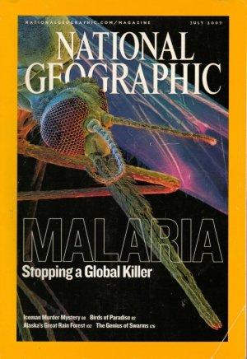
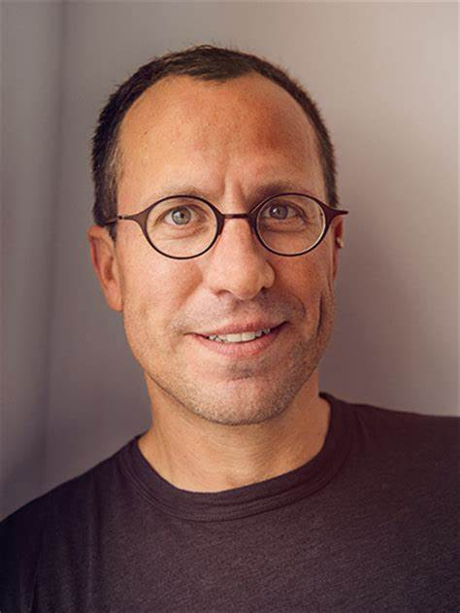
The magazine and the author

Slide 4
Stopping a global killer
A mosquito bite and the spread of malaria
The truth of malaria
The global awareness and efforts
… (other topics?)
In-class writing 501 (5 minutes)

Slide 5
Close-up reading
Choice of different materials
Organization of different materials
Presentation of different materials
Some cases of creative writing
Close-up reading (Week 5).docx

Slide 6
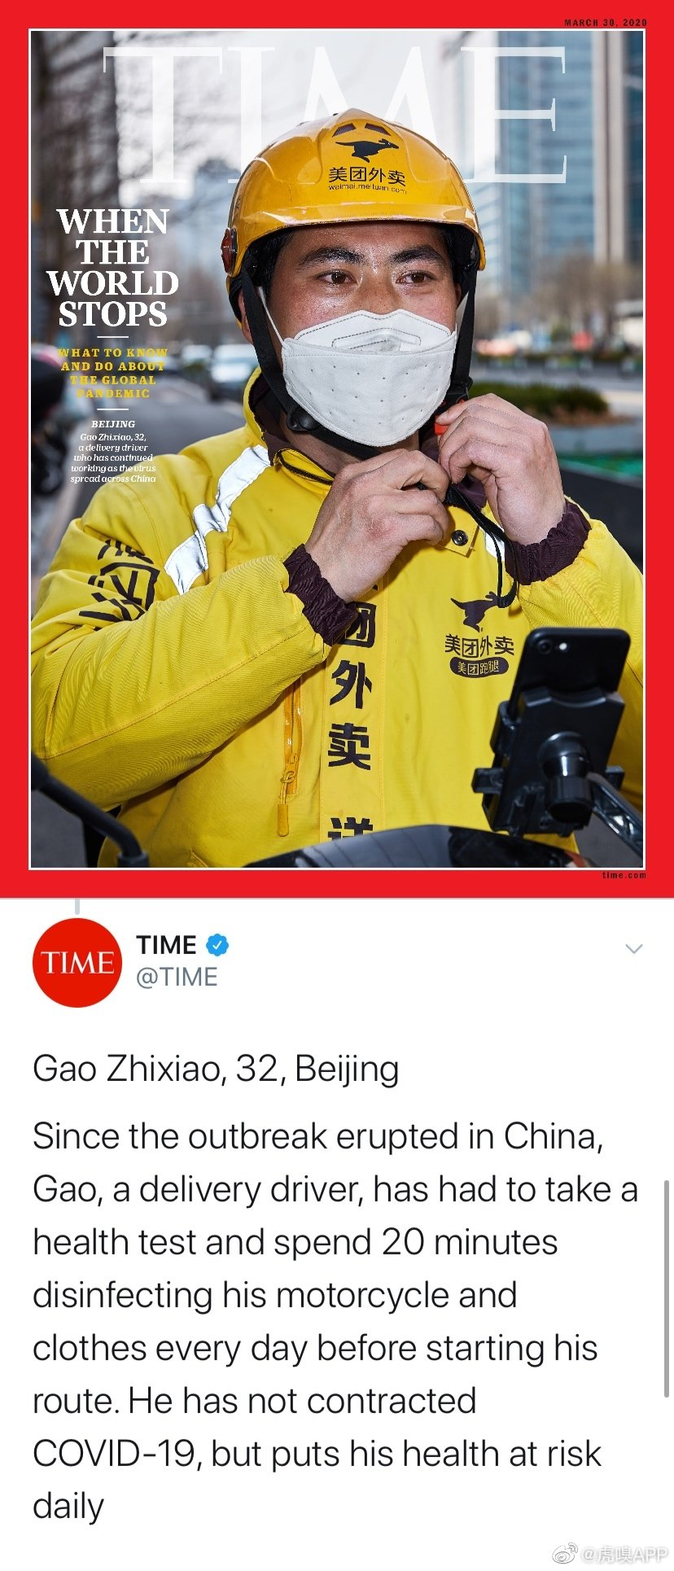
Feature article
A feature article is much more than a collection of bare facts. It's a special-interest article abounding with details that makes for pleasurable reading. While a hard news article focuses on exactly what happened, when and to whom, a feature article typically adds a dimension of human interest.

Slide 7
Feature article
Feature articles frequently contain a story line and often have entertainment value. Rather than reciting the plain facts, they go into a topic more in-depth. Background research, descriptions, quotations and personal interviews add interest to features.

Slide 8
Writing a feature article
While writing a feature article takes lots of planning, research, and work, doing it well is a great way to creatively write about a topic you are passionate about and is a perfect chance to explore different ways to write!

Slide 9
Steps to write a feature article
Step 1: Choosing a story
Step 2: Interviewing subjects
Step 3: Preparing to write the article
Step 4: Writing the article
Step 5: Finalizing the article
Source: https://www.wikihow.com/Write-a-Feature-Article

Slide 10
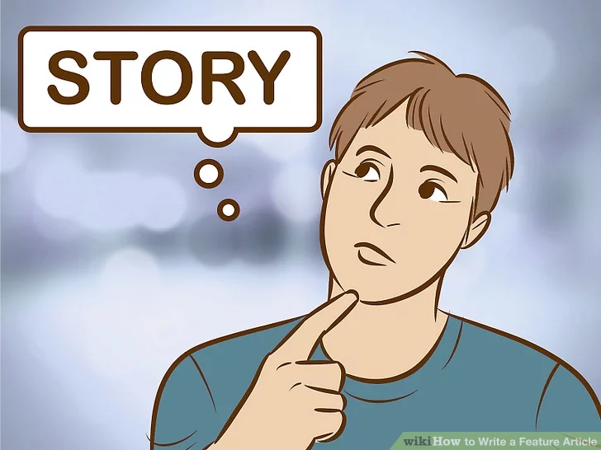
101 Find a compelling story
Think about a new and innovative way to tell the story

Slide 11

102 Do research on your topic
Focus and perspectives
Online research
Books and magazines
Historical data

Slide 12
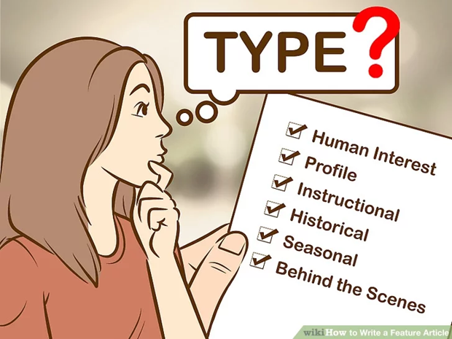
103 Decide on the type of feature
Depending on your focus

Slide 13
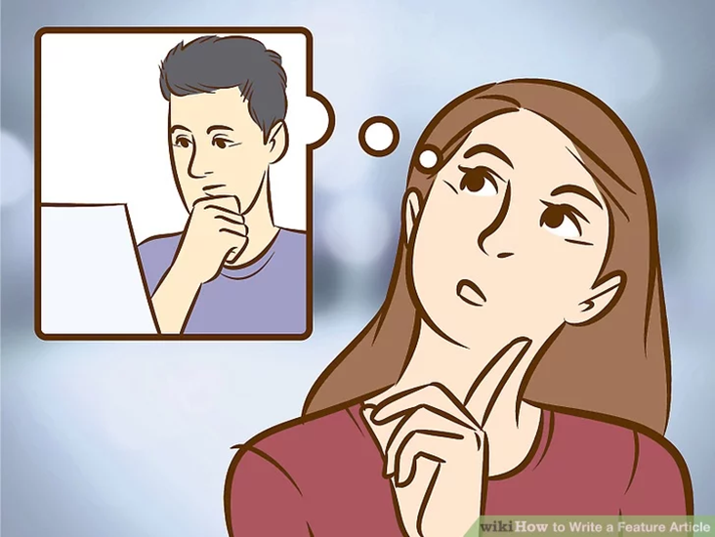
104 Consider the audience
Who will be my readers?
What kind of angels appeal to these readers?

Slide 14
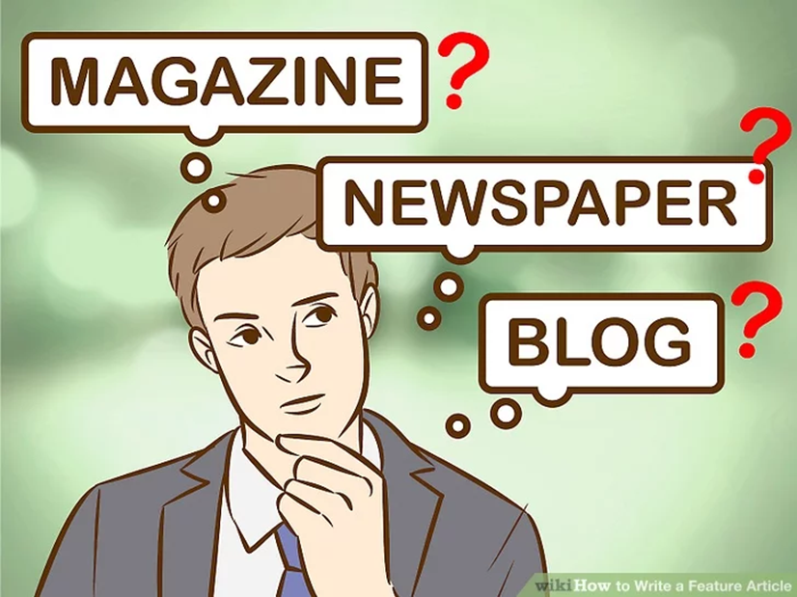
105 Consider the type of publication
Readership
General styles and features

Slide 15
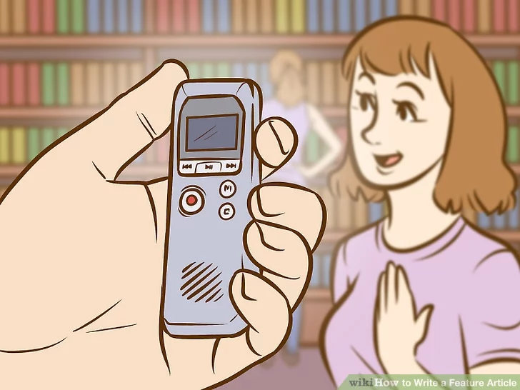
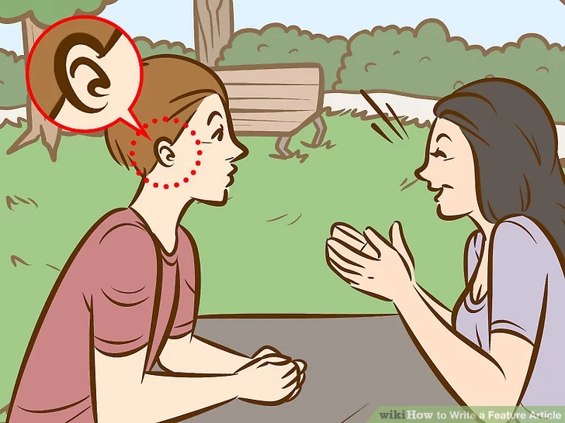
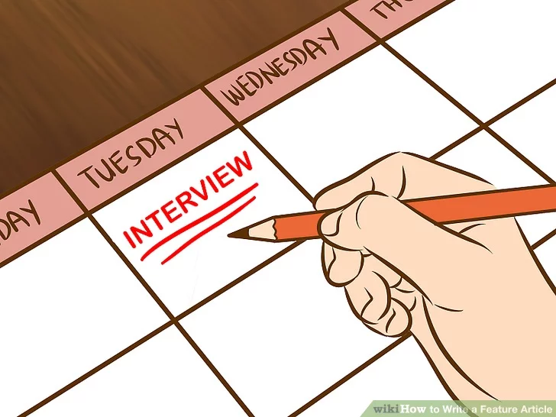
Step 2: Interviewing subjects

Slide 16
Step 3: Preparing to writing the article

Slide 17

301 Choose a format
Not the “inverted pyramid”
A dramatic opening
Story-within-story structure

Slide 18
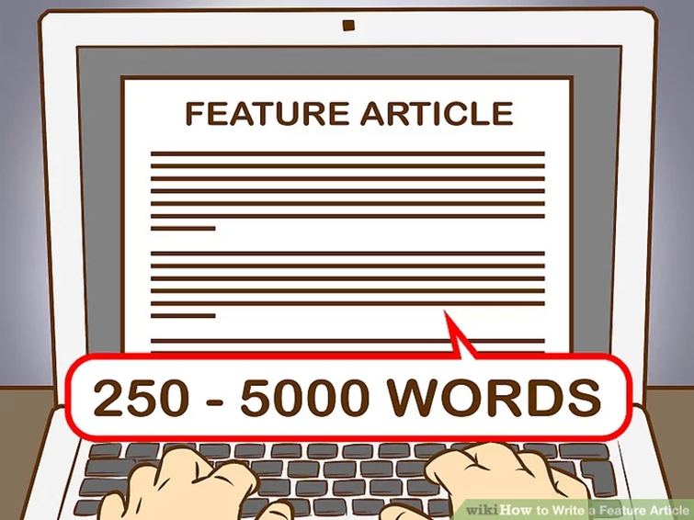
302 Decide on approximate length
Newspaper feature stories run between 500 and 2,500 words
Magazine features run from 500 to 5,000 words.
Blog features run from 250 to 2,500 words.

Slide 19
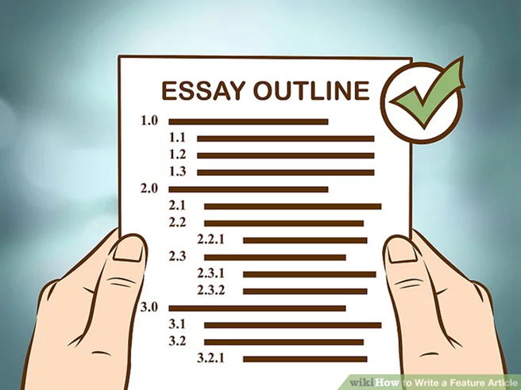
303 Outline your article
Be selective

Slide 20
Step 4: Writing the article

Slide 21
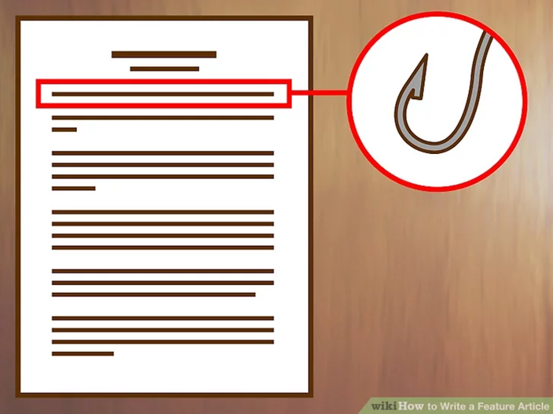
401 Open your story with a “hook”
an interesting fact, a quote, or an anecdote

Slide 22
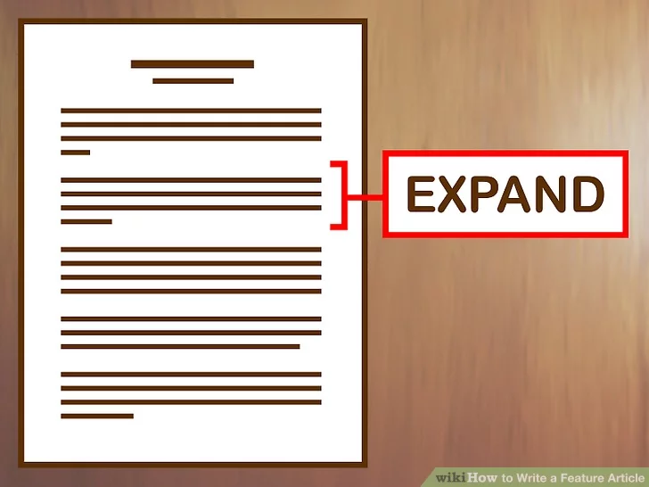
402 Expand your lead in the next paragraphs
Why are we reading this story?
What is important about it?

Slide 23
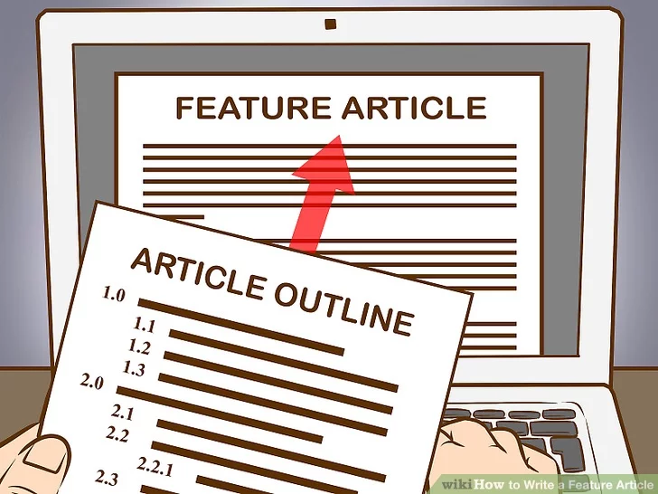
403 Follow your outline
Be flexible, however.

Slide 24
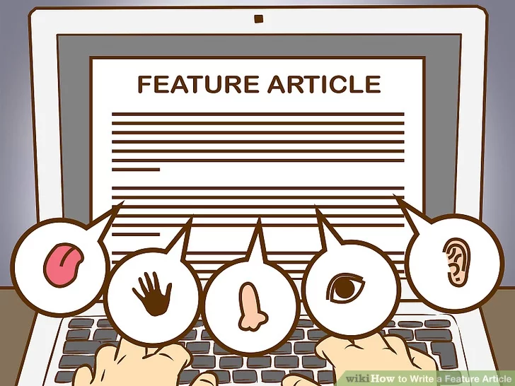
404 Show, don’t tell
Describe a setting or person so that the reader can clearly envision it in their mind.

Slide 25

405 Don’t use too many quotes
Write around their quotes to give them context, build the story and help the reader interpret what the interviewee is saying.

Slide 26
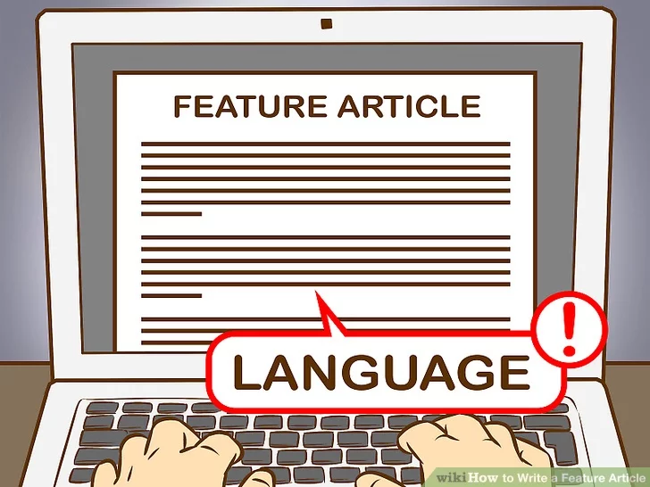
406 Choose appropriate language
Target audience
Publication

Slide 27
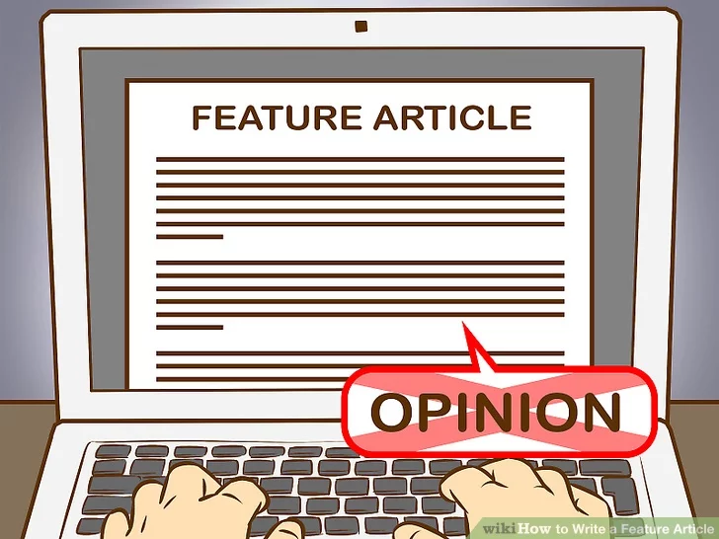
407 Keep your opinion OUT of the article
It’s not about YOU!
Your personality is conveyed through your writing style

Slide 28
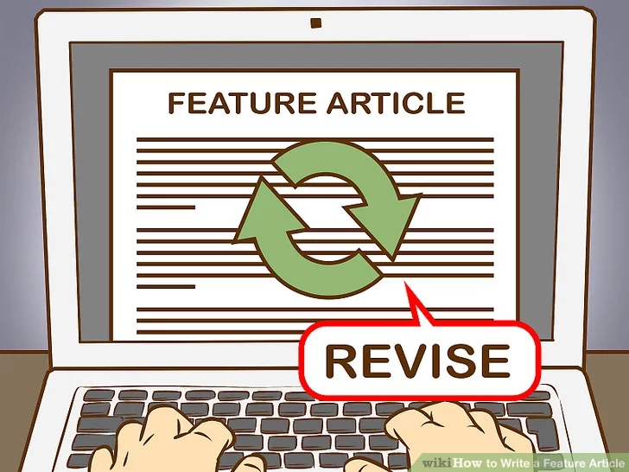
408 Revise your article
Think of ways to sharpen descriptions, clarify points and streamline explanations.

Slide 29
Step 5: Finalizing the article

Slide 30
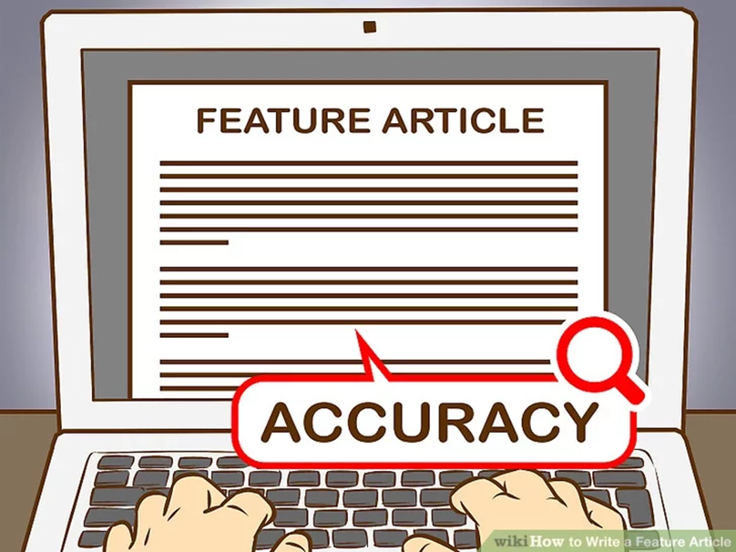
501 Check for accuracy
Names, order of events, and other pertinent details

Slide 31

502 Have your subjects read the article
Optional
Flexible

Slide 32
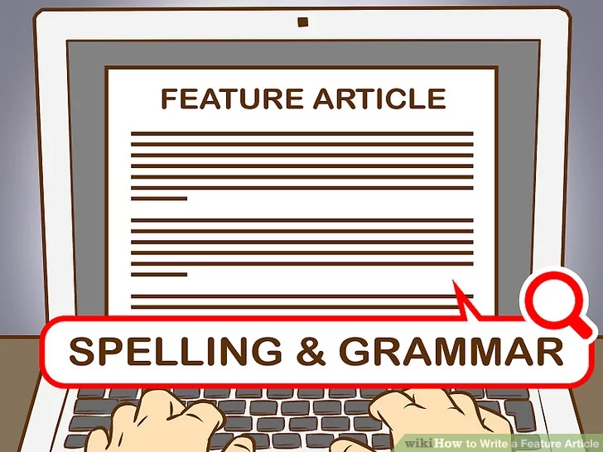
503 Check spelling and grammar
“The Elements of Style,"
"The Associated Press Stylebook"

Slide 33
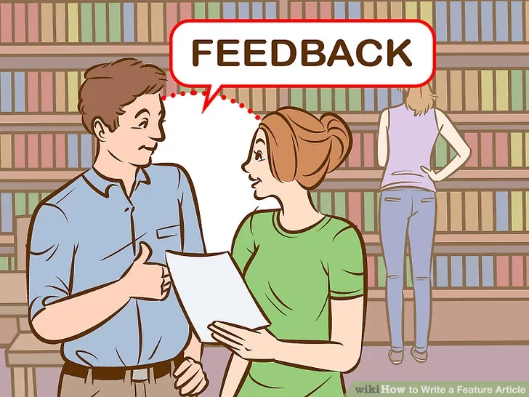
504 Get feedback on the article
Friends and colleagues
Editors

Slide 34
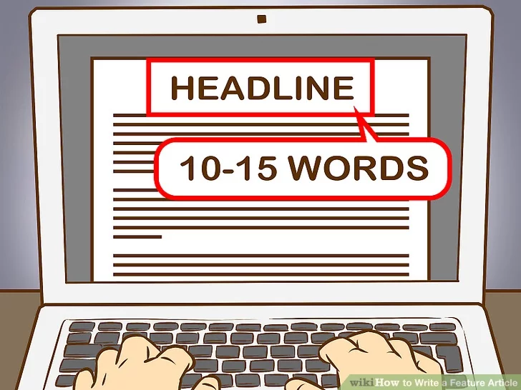
505 Write a headline
Optional
The headline is short and to the point, using no more than about 10-15 words

Slide 35
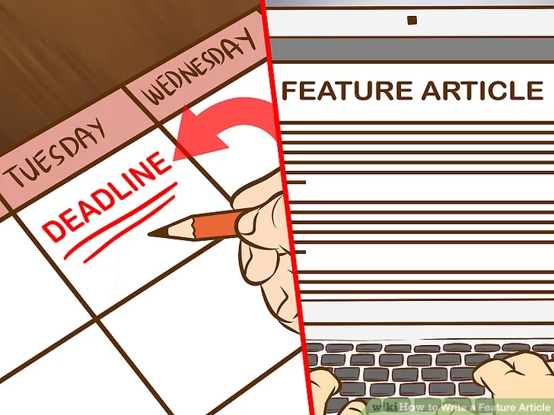
506 Submit your article by the deadline

Slide 36
In-class writing
Write an outline of your feature article
→ Focus, Audience, Structure, Materials, etc.
30 minutes
Submission before midnight. （学在浙大）

Slide 37
Homework
1. Start to write a feature article about COVID-19
2. About 1000 words
3. A proper title,
→ Facts, quotes, statistics; → Use an analogy
→ Explanation of important concepts or terms
→ Narration+ description + exposition

